Slide 1
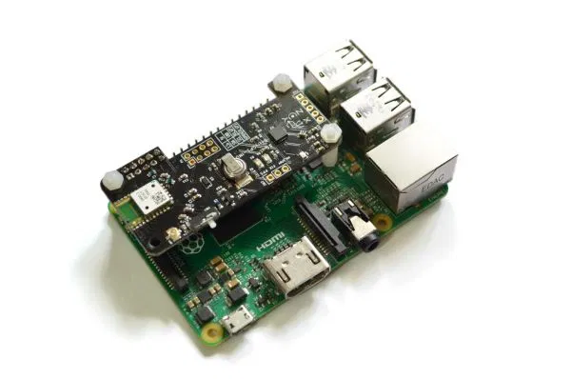
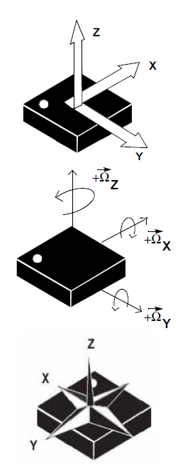
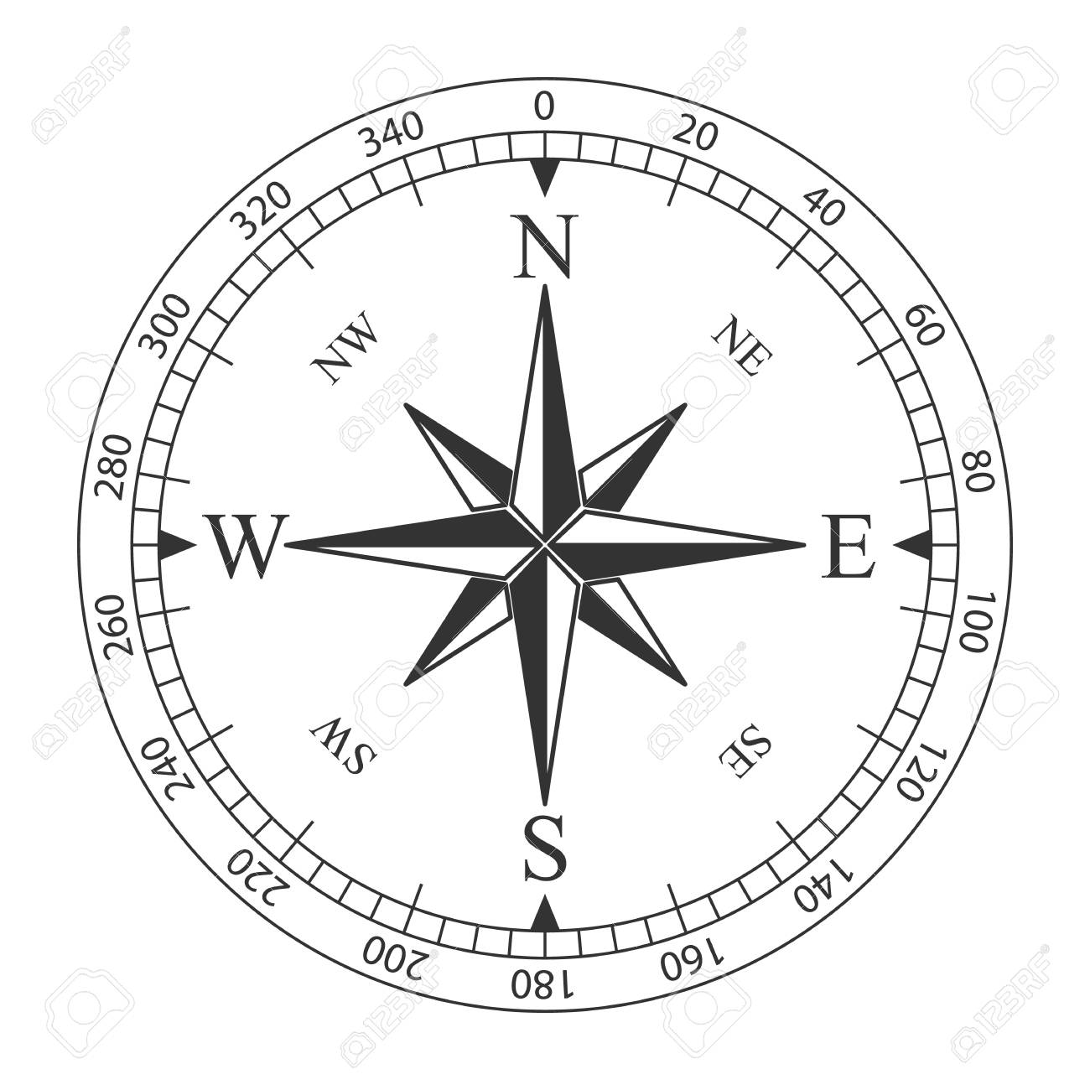
Berry IMU Coordinate System (using BerryIMU base)
MagZ
Axis positive (+) when pointing into opposite direction of gravity and give a positive reading.
Positive (+) rotation when rotated around the axis as shown in sketch.
North aligned with y-axis from accelerometer
if heading is derived as
MagY
+Z= Heave
+Y = Sway
+Yaw
+X= Surge
MagX
+Pitch
+Roll

Slide 2
Data Header
Time stamp
AccX(m/s^2), AccY(m/s^2), AccZ(m/s^2) filtered accelerations with low pass routine you had provided in the variable ‘filtered_accel’
GyrX(rad/s), GyrY(rad/s), GyrZ(rad/s) directly from Gyroscope
Roll(deg), Pitch(deg), Yaw(deg), your variable ‘rpy’
Heading derived from Magnetometer values
X(m), Y(m), Z(m), displacement from your variable ‘p_xyz’
Vx(m/s), Vy(m/s), Vz(m/s), from your variable ‘v_xyz’
AccXraw(m/s^2), AccYraw(m/s^2), AccZraw(m/s^2), acceleration directly from sensor no low pass filter
RollAcc(deg/s^2), PitchAcc(deg/s^2), angular acceleration from your variable ‘rpy_accel’
Latitude, Longitude, GPS data reading
GPShspeed(m/s), GPSalt(m) GPS data reading
MagX(uT), MagY(ut), MagZ(uT), magnetometer readings directly from sensor

Slide 3
Sample Data Sets provided
Data Set 1 – Resting pointing North (Set1-Resting_END18-06-2020_13-28-54.csv)
Data Set 2 and 3 (Set2-Clockwise Rectangle-1.csv, Set3-Clockwise Rectangel-2.csv) moving along rectangle clockwise –SEE Figure 1
Data Set 4,5 and 6 moving along rectangle counter clockwise – SEE Figure 2
33cm
Figure 2
33cm
START
Figure 1
27cm
27cm
START

